Slide 1
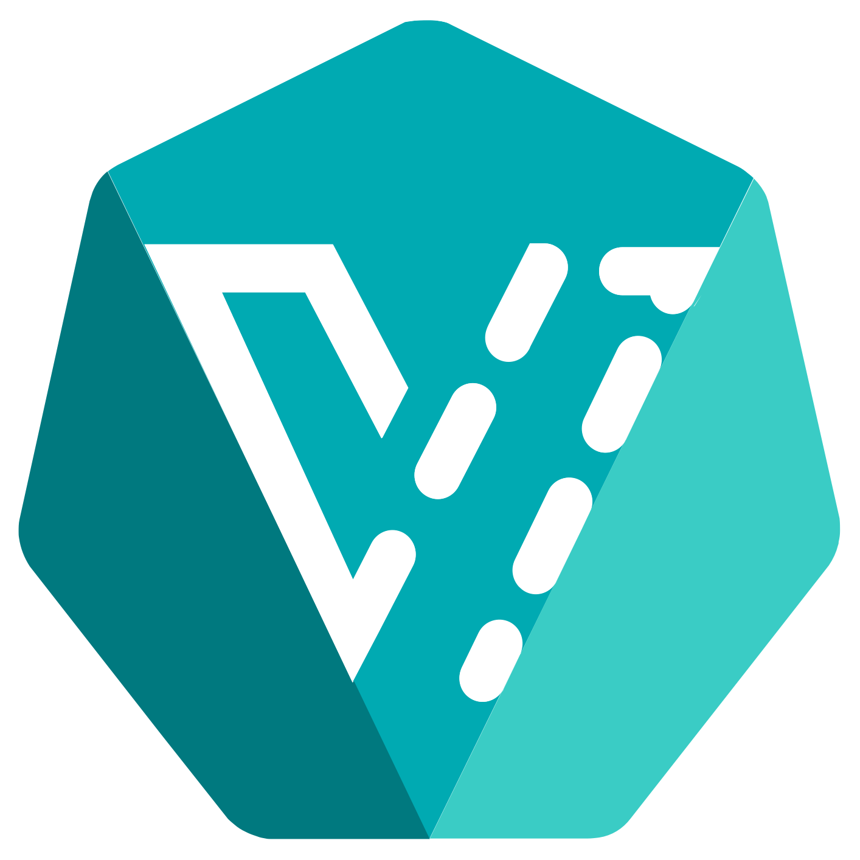
OpenShift 4.x Architecture Workshop
Container Native Virtualisation
July 2019

Slide 2
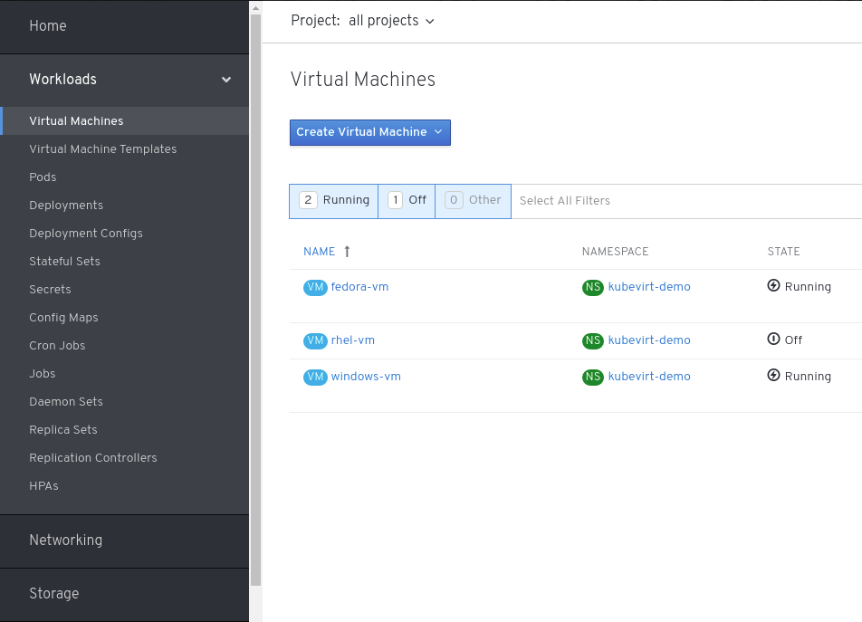

CONTAINER-NATIVE VIRTUALIZATION
CNV 1.4 Tech Preview
Basic live migration
Containerized data importer
Progress reporting
Disk expansion
Blank disks
Operators for KubeVirt, Containerized data importer
UI Enhancements
RDP, Serial, VNC, consoles
CRUD Disks, VM templates
Notes:
CNV 1.4:
Basic Live Migration
Containerized-data Importer (CDI) improvements
Report progress of clone, import.
Support blank disks
Expand imported disk to fill PVC
Operators (KubeVirt, CDI, Console)
Driver disk installation and Windows validation
UI Enhancements
RDP, Serial, VNC, consoles
CRUD Disks, VM templates
API stabilization/rationalization

Slide 3

CONTAINER-NATIVE VIRTUALIZATION
General Availability (Later)
Focus on providing the simplest way to deploy a complete infrastructure that runs virtual machines and containers and can scale from a small cluster to hundreds of nodes with frictionless lifecycle management.
CNV
App
App
App
App
Storage
(OCS)
Container
VM
VM
Container
Container
Container
KVM
OpenShift Container Platform
Compute
(CRI)
Networking
(CNI)
Storage
(CSI)
Ironic
standard hardware

Slide 4
CONTAINER-NATIVE VIRTUALIZATION
General Availability (Later)
Focus on providing the simplest way to deploy a complete infrastructure that runs virtual machines and containers and can scale from a small cluster to hundreds of nodes with frictionless lifecycle management.
Why?
Ensure customer success.
Simplify user experience.
Respond to demand.
BM clusters.
Small footprints.
CNV
App
App
App
App
Storage
(OCS)
Container
VM
VM
Container
Container
Container
KVM
OpenShift Container Platform
Compute
(CRI)
Networking
(CNI)
Storage
(CSI)
Ironic
standard hardware
Notes:
Single storage footprint!
Use Case/Market
VMs able to support databases for IMS or RHV migrations (MS SQL).
Containers to support cloud native applications (Mongo, Couchbase, Spark, Kafka) and developer workflows (Jenkins) to leverage existing workload testing.
Requirements “Usability over features”
Management: Single GUI for all operations. The customer should never need to touch the CLI.
Architecture: 3 node minimum with +1 node scaling up to 12 nodes.
Partners: Min. 1 OEM partner or self-certification on OEM hardware, 1 public cloud bare-metal option.
Solution Arch: Data sheets with performance information for “anchor” workloads on reference hardware.

Slide 5
CONTAINER-NATIVE VIRTUALIZATION
General Availability (Later)
Focus on providing the simplest way to deploy a complete infrastructure that runs virtual machines and containers and can scale from a small cluster to hundreds of nodes with frictionless lifecycle management.
How?
Single integrated user experience
Prescriptive hyper-converged infrastructure using Kubernetes
Validated hardware platforms & workloads
CNV
App
App
App
App
Storage
(OCS)
Container
VM
VM
Container
Container
Container
KVM
OpenShift Container Platform
Compute
(CRI)
Networking
(CNI)
Storage
(CSI)
Ironic
standard hardware
Notes:
Single storage footprint!
Use Case/Market
VMs able to support databases for IMS or RHV migrations (MS SQL).
Containers to support cloud native applications (Mongo, Couchbase, Spark, Kafka) and developer workflows (Jenkins) to leverage existing workload testing.
Requirements “Usability over features”
Management: Single GUI for all operations. The customer should never need to touch the CLI.
Architecture: 3 node minimum with +1 node scaling up to 12 nodes.
Partners: Min. 1 OEM partner or self-certification on OEM hardware, 1 public cloud bare-metal option.
Solution Arch: Data sheets with performance information for “anchor” workloads on reference hardware.

Slide 6
Windows Container

Slide 7
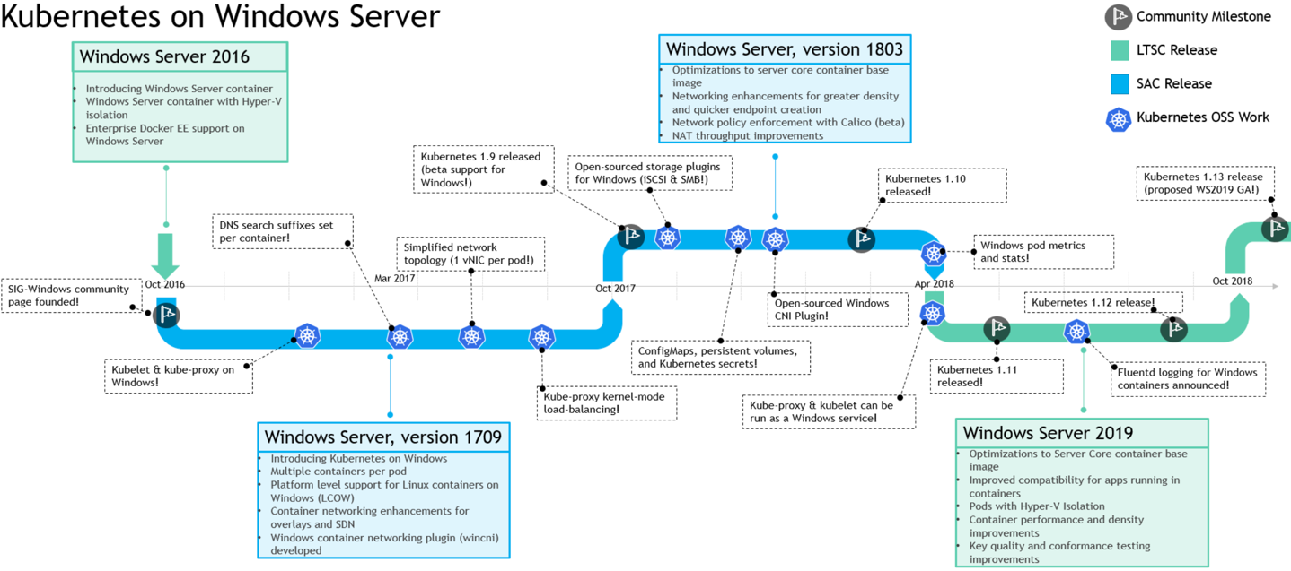
Windows Containers - Developer Preview
Windows Containers are developer preview
Windows Containers are not moving to tech preview in OCP 4.0
Apply HERE to get access to THIS and be able to ask questions HERE
Product Manager: Mike Barrett
Notes:
https://blogs.technet.microsoft.com/networking/2018/09/19/ws2019-kubernetes/
Windows containers missed GA in the upstream in kube 1.13. Microsoft is trying for kube 1.14 currently. Right now we know we need kube 1.14 in OCP to support them. Remember, this is both Microsoft and Red Hat claiming support. Red Hat will not be shipping the windows binaries and so we need to wait until Microsoft declares them as supported.
The next big item is the network solution. Both Red Hat and Microsoft would prefer it if our mutual customers did not have to purchase 3rd party software to get this solution to work. Therefore, we need a network integration between OVN and Windows HSN interfaces in their operating system. Both companies are funding a mutual development project for the second half of 2019. This is not a blocker to GA in that technically a customer could bring in a 3rd party network like Calico and receive support from Tigera.
The last big item is integrating Windows nodes into either the IPI or UPI installation method and operator architecture of OCP 4.x. That work is ongoing.

Slide 8
Thank you !

